Slide 1
NAKUJA 4 SOLIDS TEAM
WEEK 4 PROGRESS REPORT

Slide 2
WEEK’S OBJECTIVES
Machining of the bulkhead.
3D design and printing of grain base and mold.
Research for proper pressure sensure fittings.
Ignition system simulation.
Draft application letter for workshops
Ansys Training

Slide 3
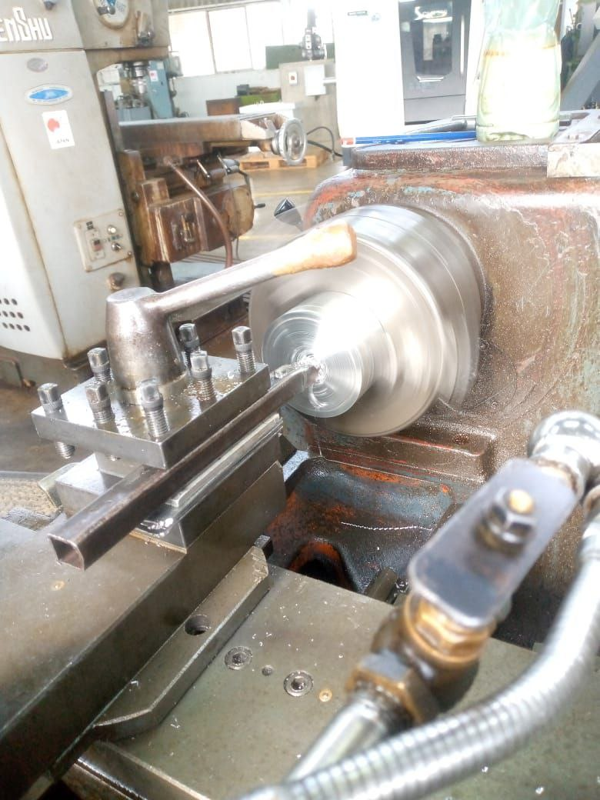
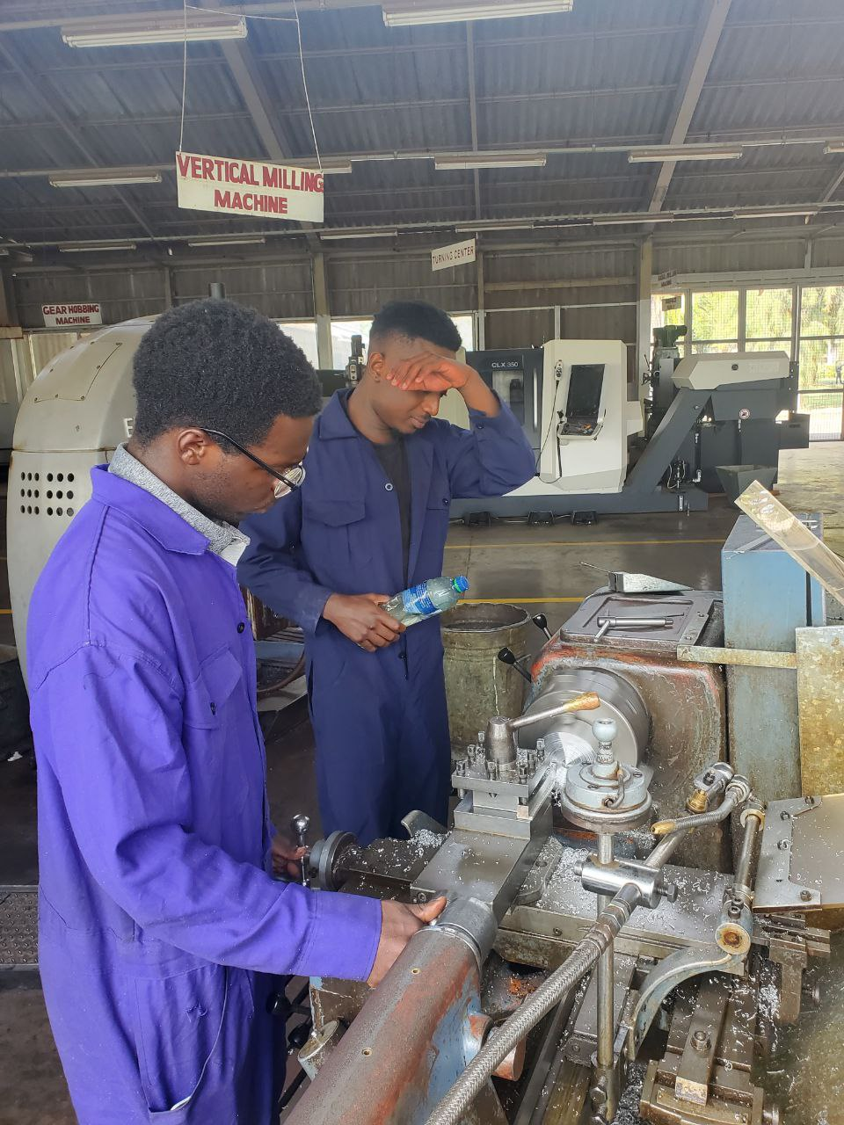
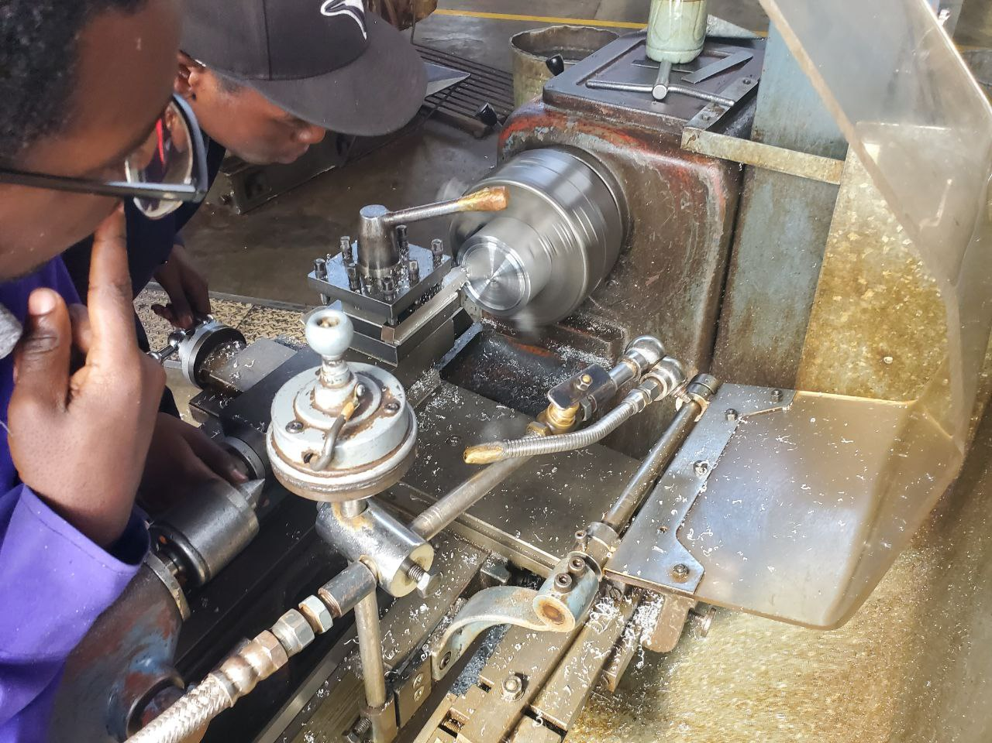
Machining of the bulkhead
Turning of the bulkhead

Slide 4
Bulkhead Machining
We started with a 120 mm long, 100 mm diameter aluminum rod
Cut into two blanks of 60 mm each.
Then performed Facing & Length Reduction. The Outer diameter reduced to 92 mm
Bored to 72 mm diameter, 40 mm depth
To Maintain tight tolerances, O-Ring Groove Machining is done and two circumferential grooves added
ChatGPT can make mistak
https://docs.google.com/document/d/1eWtSQq8ITQwnH-MtcHJcADd2jAYv9mzV9yFNSUg7WsI/edit?usp=sharing

Slide 5
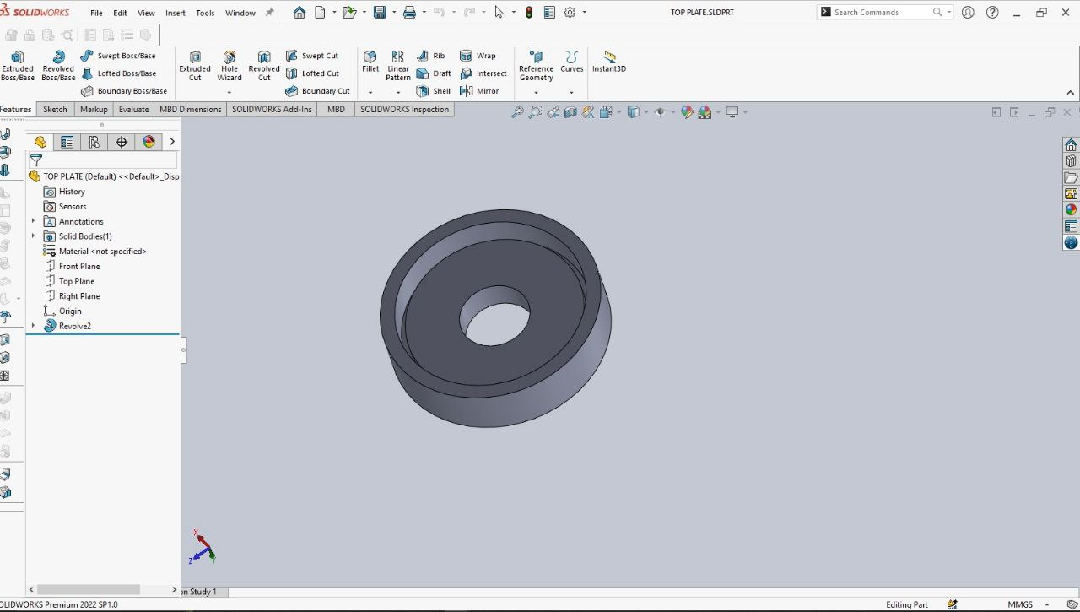
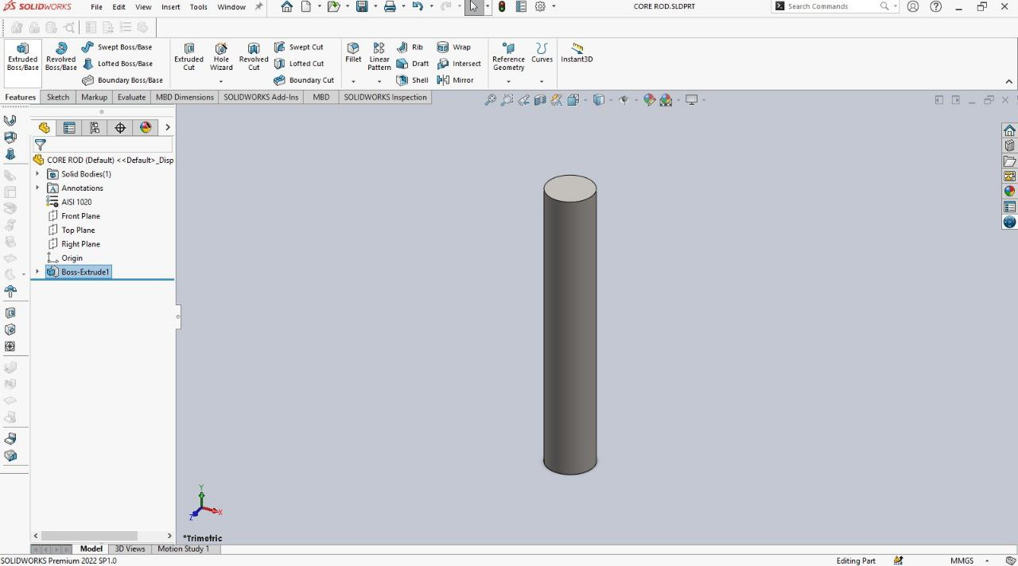
3D design and printing of grain base and mold.
The grain geometries influence the burn rate, thrust curve, and overall performance of the solid rocket motor.
By optimizing the grain geometry, we can precisely control the burning surface area, leading to desired thrust profiles.
https://github.com/nakujaproject/internship2025/tree/main/Solid%20Propulsion/Grains/KNSB_Ratio_Justification

Slide 6
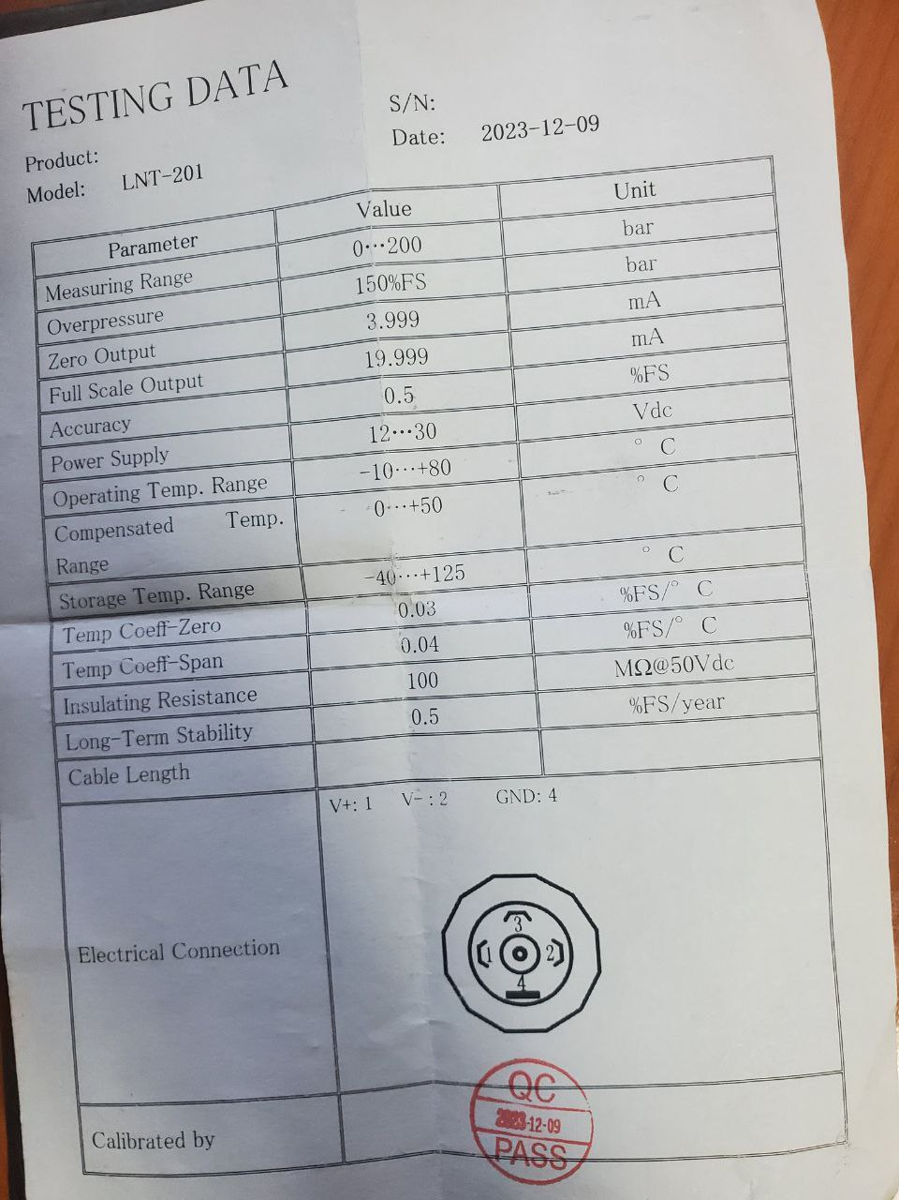
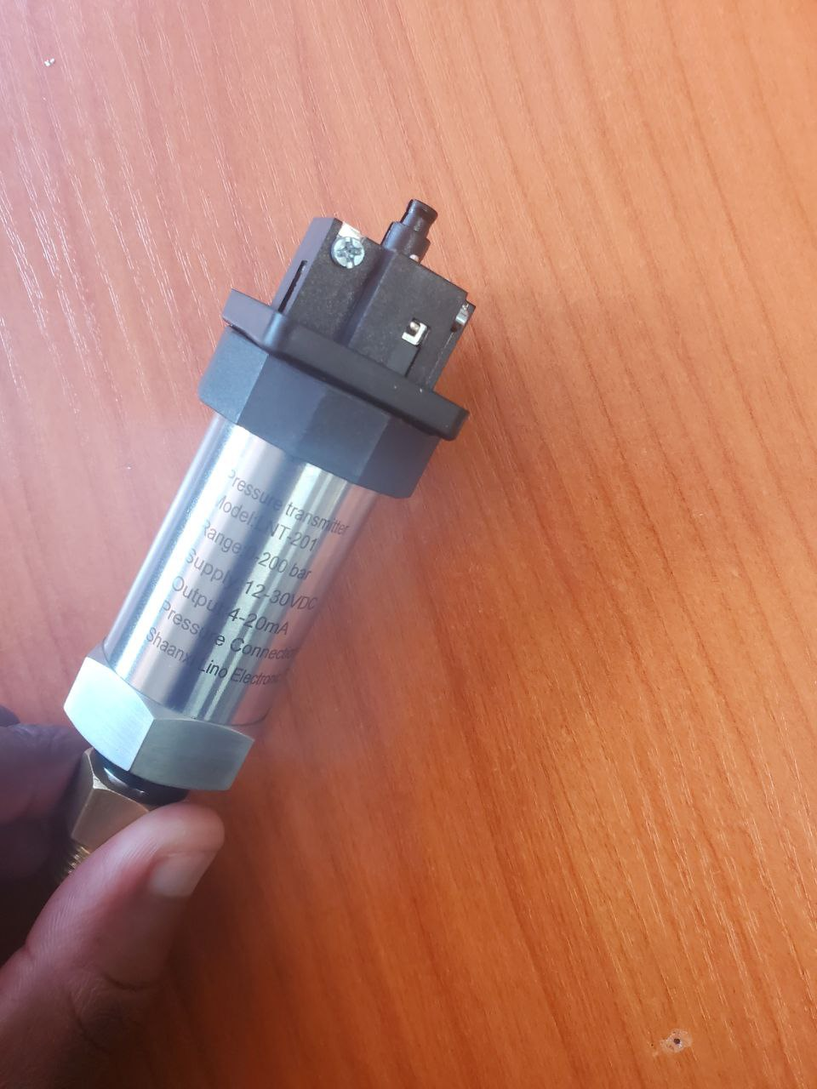
Research for proper pressure Transmitter fittings.
Model: LNT-201
Measurement Range: 0 - 200 bar
Supply Voltage: 12 - 30V DC
Output Signal: 4 - 20 mA
Terminals: 4-wire configuration (V+:1, V-:2, GND:4 ) Terminal 3 is unconneted.
LNT-201 Pressure Transmitter and its data sheet

Slide 7
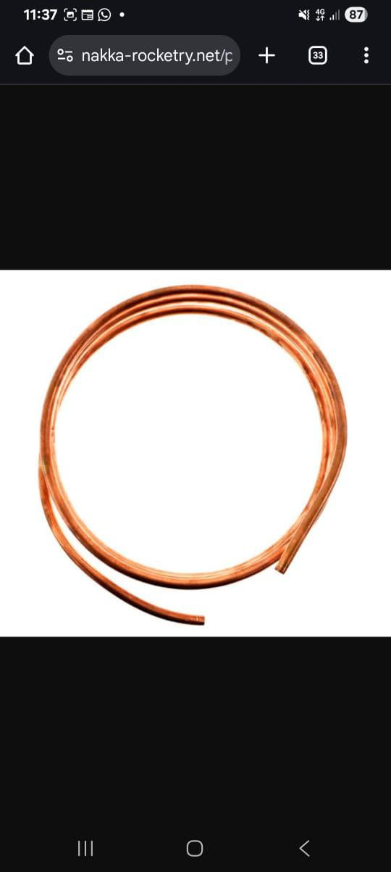
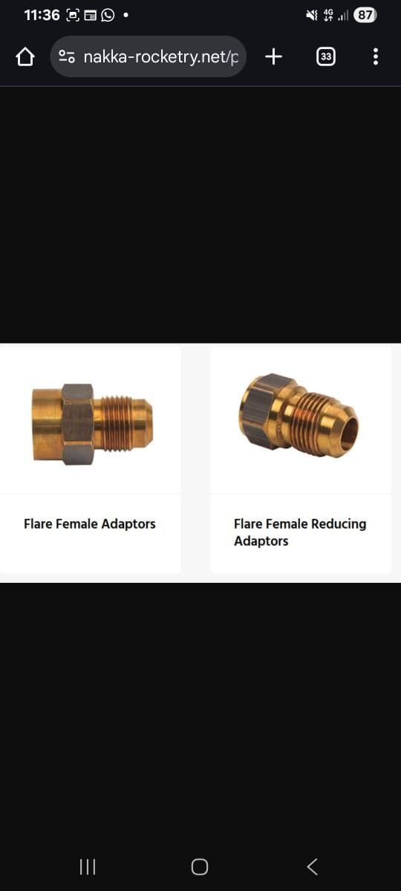
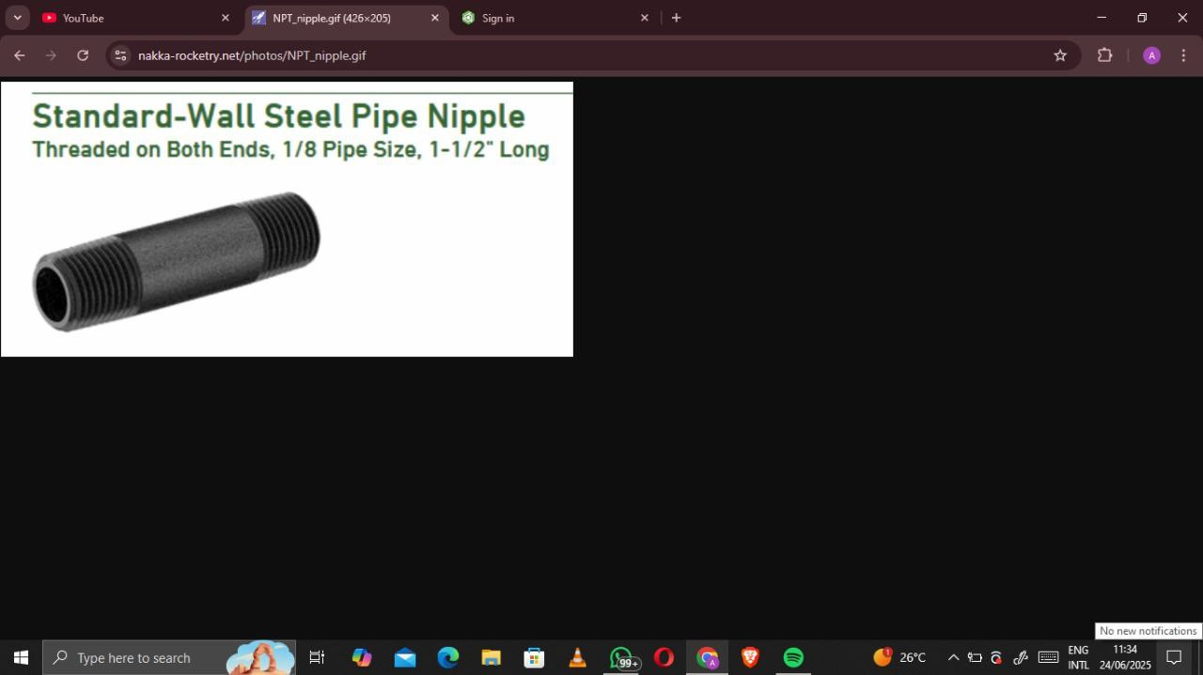
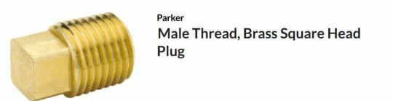
These are the fittings to be purchased to assemble the pressure sensor.
https://www.nakka-rocketry.net/pressure-measurement.html

Slide 8
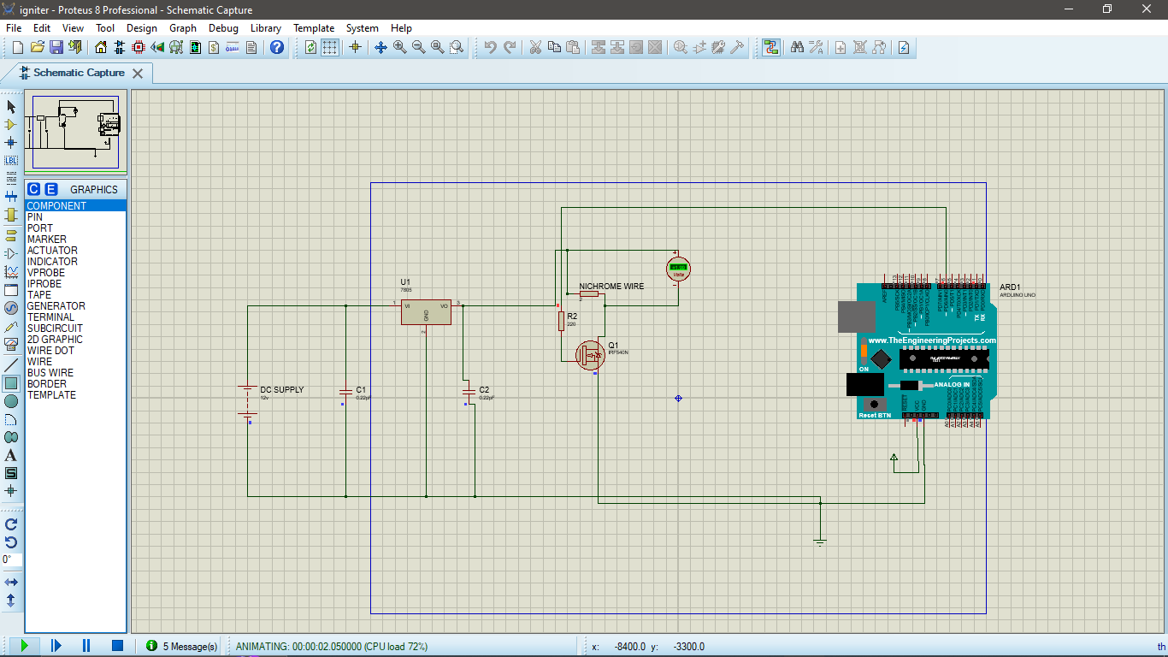
Ignition system simulation
System Description
This system is designed to ignite black powder using a heated nichrome wire.
Remote Triggering (ESP-NOW)
A second ESP32 module (transmitter) sends a wireless trigger signal to the receiver ESP32.When the receiver gets the signal, it drives the MOSFET gate HIGH for a brief duration(1–2 seconds), allowing ignition. After ignition, the gate is set LOW, turning off the circuit.
https://www.nakka-rocketry.net/igniter.html#Pressure
https://docs.google.com/document/d/1bPKG8Aen2Dh6u6OgGsQVXacWKGBV_ysDI4zZ7qTzZXE/edit?usp=sharing

Slide 9
Draft a Request letter for workshops
The purpose of the Letter is to formally express interest in using the carpentry workshop for turning the wood for the mandrel.
The Mandrel drawing and the request letter can be accessed through the link below
Due to fabrication of a new mandrel, we are required to use the machines in the capentry shop for turning and other operations.
This neccesitated the need for a request letter which will indicate the name and regestration number of the interested students which will be brought forward to the technician in the capentry workshop for verification.
The CAD drawing of the mandrel and the request letter are linked below
https://docs.google.com/document/d/1RKsdHZxTvtQesrKOfE22Ir1fFwHcWPo5GdWflOouqA4/edit?usp=sharing

Slide 10
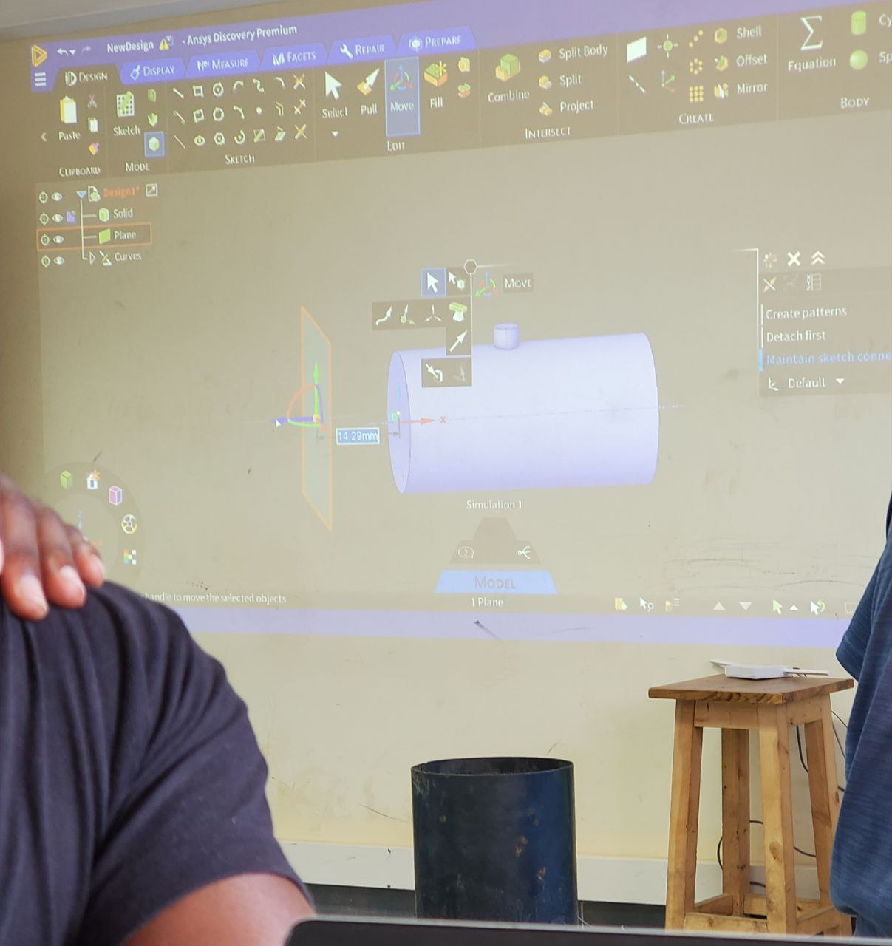
Ansys Training
We were introduced to CFD.
The Software Demonstration was airflow in a cylinder.We had:
Mesh generation
Boundary Condition setup
Solver Configuration
Result Interpretation
Some of the application of CFD include:
Aerospace
Automotive
Civil
Biomedical

Slide 11
Challenges Encountered
1. The ongoing protests led to the closure of hardware and suppliers that stock specialized pressure transmitter fittings.This unforeseen factor delayed the procurement of necessary pressure transmitter fittings for the physical setup and testing.

Slide 12
NEXT WEEK’S OBJECTIVES
Refurbishment of the test stand
3D Printing of Casting Tools
Cooking Grains
Soldering of Sound Alarm System PCB
Machining of bulk head and nozzle

Slide 13
